Slide 1
SORTING Heap Sort & Mergesort

Slide 2
A Heap Is Efficiently Represented As An Array
9
8
7
6
7
2
6
5
1
9
8
7
6
7
2
6
5
1
0
1
2
3
4
5
6
7
8
9
10

Slide 3
Inserting An Element Into A Max Heap
9
8
7
6
7
2
6
5
1
7
Complete binary tree with 10 nodes.

Slide 4
Inserting An Element Into A Max Heap
9
8
7
6
7
2
6
5
1
7
7
New element is 20.

Slide 5
Inserting An Element Into A Max Heap
9
8
7
6
2
6
5
1
7
7
7
New element is 20.

Slide 6
Inserting An Element Into A Max Heap
9
7
6
8
2
6
5
1
7
7
7
New element is 20.

Slide 7
Inserting An Element Into A Max Heap
20
9
7
6
8
2
6
5
1
7
7
7
New element is 20.

Slide 8
Complexity Of Insert
20
15
7
6
9
2
6
5
1
7
8
7
8
7
Complexity is O(log n), where n is heap size.

Slide 9
Removing The Max Element
20
15
7
6
9
2
6
5
1
7
8
7
8
7
Max element is in the root.

Slide 10
Removing The Max Element
15
7
6
9
2
6
5
1
7
8
7
8
7
After max element is removed.

Slide 11
Removing The Max Element
15
7
6
9
2
6
5
1
7
8
7
8
7
Heap with 10 nodes.
Reinsert 8 into the heap.

Slide 12
Removing The Max Element
15
7
6
9
2
6
5
1
7
7
7
Reinsert 8 into the heap.

Slide 13
Removing The Max Element
15
7
6
9
2
6
5
1
7
7
7
Reinsert 8 into the heap.

Slide 14
Removing The Max Element
15
9
7
6
8
2
6
5
1
7
7
7
Reinsert 8 into the heap.

Slide 15
Removing The Max Element
15
9
7
6
8
2
6
5
1
7
7
7
Max element is 15.

Slide 16
Removing The Max Element
9
7
6
8
2
6
5
1
7
7
7
After max element is removed.

Slide 17
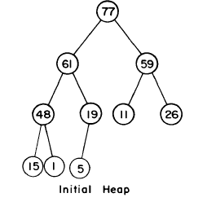
HeapSort

Slide 18
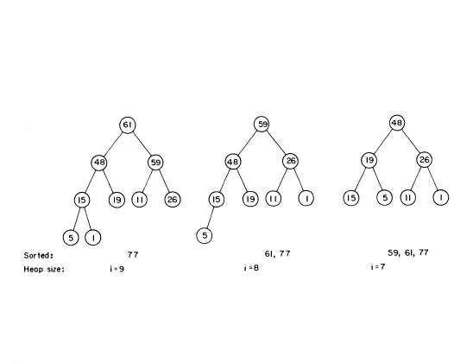

Slide 19
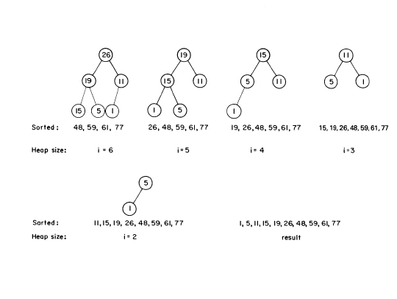

Slide 20
Complexity Of Sorting
Sort n elements.
n insert operations => O(n log n) time.
n remove max operations => O(n log n) time.
total time is O(n log n).

Slide 21
Heap Sort
Uses a max priority queue that is implemented as a heap.
Initial insert operations are replaced by a heap initialization step that takes less time.

Slide 22
Initializing A Max Heap
1
2
3
4
5
6
7
8
9
7
11
7
8
10
input array = [-, 1, 2, 3, 4, 5, 6, 7, 8, 9, 10, 11]

Slide 23
Initializing A Max Heap
1
2
3
4
5
6
7
8
9
7
11
7
8
10
Start at rightmost array position that has a child.
Index is n/2.

Slide 24
Initializing A Max Heap
1
2
3
4
11
6
7
8
9
7
5
7
8
10
Move to next lower array position.

Slide 25
Initializing A Max Heap
1
2
3
4
11
6
7
8
9
7
5
7
8
10

Slide 26
Initializing A Max Heap
1
2
3
9
11
6
7
8
4
7
5
7
8
10

Slide 27
Initializing A Max Heap
1
2
3
9
11
6
7
8
4
7
5
7
8
10

Slide 28
Initializing A Max Heap
1
2
7
9
11
6
3
8
4
7
5
7
8
10

Slide 29
Initializing A Max Heap
1
2
7
9
11
6
3
8
4
7
5
7
8
10

Slide 30
Initializing A Max Heap
1
11
7
9
6
3
8
4
7
5
7
8
10
Find a home for 2.

Slide 31
Initializing A Max Heap
1
11
7
9
10
6
3
8
4
8
7
7
5
Find a home for 2.

Slide 32
Initializing A Max Heap
1
11
7
9
10
6
3
8
4
7
7
8
2
5
Done, move to next lower array position.

Slide 33
Initializing A Max Heap
1
11
7
9
10
6
3
8
4
2
7
7
8
5
Find home for 1.

Slide 34
Initializing A Max Heap
11
7
9
10
6
3
8
4
2
7
7
8
5
Find home for 1.

Slide 35
Initializing A Max Heap
11
10
7
9
6
3
8
4
2
7
7
8
5
Find home for 1.

Slide 36
Initializing A Max Heap
11
10
7
9
5
6
3
8
4
2
7
7
8
Find home for 1.

Slide 37
Initializing A Max Heap
11
10
7
9
5
6
3
8
4
2
7
7
8
1
Done.

Slide 38
Time Complexity
11
9
7
8
5
6
3
1
4
7
7
8
10
2
Height of heap = h, Number of nodes at level j is 2 ^{j-1}
Number of subtrees with root at level j is <= 2 ^{j-1}.
Time for each subtree is O(h-j).

Slide 39
Complexity
Time for level j subtrees is <= 2^{j-1}(h-j)
Total time required is 1≤ j <h
∑ 2^{j-1}(h-j) = ∑ 2^{h-j-1} (j) ≤ n ∑ 2^{-j} (j) ≤ 2n = O(n)

Slide 40
HeapSort

Slide 43
Time Complexity
11
9
7
8
5
6
3
1
4
7
7
8
10
2
Height of heap = h, h-1, h-2…1, Number of nodes at level j is 2 ^{j-1}
Time for each deletion is O(j) for a tree of height j.

Slide 44
Complexity
Time for level j deletions is <= 2^{j-1}(j)
Total time required is 1≤ j ≤ h
∑ 2^{j-1}(j ) =
O(nlogn)

Slide 45
Merge Sort
Partition the n > 1 elements into two smaller instances.
.
Each of the two smaller instances is sorted recursively.
The sorted smaller instances are combined using a process called merge.
Complexity is O(n log n).
Usually implemented nonrecursively.

Slide 46
Merge Sort
[8, 3, 13, 6, 2, 14, 5, 9, 10, 1, 7, 12, 4]
[8, 3, 13, 6, 2, 14, 5]
[9, 10, 1, 7, 12, 4]
[8, 3, 13, 6]
[2, 14, 5]
[9, 10, 1]
[7, 12, 4]
[8, 3]
[13, 6]
[2, 14]
[5]
[9, 10]
[1]
[7, 12]
[4]
[8]
[3]
[13]
[6]
[2]
[14]
[9]
[10]
[7]
[12]

Slide 47
Merge Sort
[1, 2, 3, 4, 5, 6, 7, 8, 9, 10, 12, 13,14]
[2, 3, 5, 6, 8, 13, 14]
[1, 4, 7, 9, 10,12]
[3, 6, 8, 13]
[2, 5, 14]
[1, 9, 10]
[4, 7, 12]
[3, 8]
[6, 13]
[2, 14]
[5]
[9, 10]
[1]
[7, 12]
[4]
[8]
[3]
[13]
[6]
[2]
[14]
[9]
[10]
[7]
[12]

Slide 48
Merge Two Sorted Lists
A = (2, 5, 6)
B = (1, 3, 8, 9, 10)
C = ()
Compare smallest elements of A and B and merge smaller into C.
A = (2, 5, 6)
B = (3, 8, 9, 10)
C = (1)

Slide 49
Merge Two Sorted Lists
A = (5, 6)
B = (3, 8, 9, 10)
C = (1, 2)
A = (5, 6)
B = (8, 9, 10)
C = (1, 2, 3)
A = (6)
B = (8, 9, 10)
C = (1, 2, 3, 5)

Slide 50
Merge Two Sorted Lists
A = ()
B = (8, 9, 10)
C = (1, 2, 3, 5, 6)
When one of A and B becomes empty, append the other list to C.
O(1) time needed to move an element into C.
Total time is ?

Slide 51
Merge Sort
Downward pass over the recursion tree.
Divide large instances into small ones.
Upward pass over the recursion tree.
Merge pairs of sorted lists.
Number of leaf nodes is n.
Number of nonleaf nodes is n-1.

Slide 52
Time Complexity
Downward pass.
O(1) time at each node.
O(n) total time at all nodes.
Upward pass.
O(n) time merging at each level that has a nonleaf node.
Number of levels is O(log n).
Total time is O(n log n).

Slide 53
Natural Merge Sort
Initial sorted segments are the naturally ocurring sorted segments in the input.
Input = [8, 9, 10, 2, 5, 7, 9, 11, 13, 15, 6, 12, 14].
Initial segments are:
[8, 9, 10] [2, 5, 7, 9, 11, 13, 15] [6, 12, 14]
2 (instead of 4) merge passes suffice.
Segment boundaries have a[i] > a[i+1].

Slide 54
External Sorting
Notes:
Adaptation of quicksort exposed the need for data structures for double-ended priority queues; concept of buffers (portions of memory to read into and write from); and buffer management to reduce time spent waiting for a buffer to empty or fill to/from disk.

Slide 55
External Merge Sort
Sort 10,000 records.
Enough memory for 500 records.
Block size is 100 records.
t_{IO} = time to input/output 1 block
(includes seek, latency, and transmission times)
t_{IS} = time to internally sort 1 memory load
t_{IM} = time to internally merge 1 block load

Slide 56
External Merge Sort
Two phases.
Run generation.
A run is a sorted sequence of records.
Run merging.
Notes:
Iterative internal merge sort starts with sorted segments; performs merge passes in each of which the number of sorted segments becomes half; stops when we have just one sorted segment. The sorted segments may be created using insertion sort say to get initial segments of size 15 (say).

Slide 57
Run Generation
10,000 records
100 blocks
MEMORY
500 records
5 blocks
DISK
Input 5 blocks.
Sort.
Output as a run.
Do 20 times.
5t_{IO}
t_{IS}
5t_{IO}
200t_{IO} + 20t_{IS}

Slide 58
Merge 20 Runs
R1
R2
R3
R4
R5
R6
R7
R8
R9
R10
R11
R12
R13
R14
R15
R16
R17
R18
R19
R20
S1
S2
S3
S4
S5
S6
S7
S8
S9
S10
T1
T2
T3
T4
T5
U2
U3
U1
V1
V2
W1

Slide 59
Run Merging
Merge Pass.
Pairwise merge the 20 runs into 10.
In a merge pass all runs (except possibly one) are pairwise merged.
Perform 4 more merge passes, reducing the number of runs to 1.

Slide 60
Merge R1 and R2
Output
Input 0
Input 1
DISK
Fill I0 (Input 0) from R1 and I1 from R2.
Merge from I0 and I1 to output buffer.
Write whenever output buffer full.
Read whenever input buffer empty.

Slide 61
Merge 20 Runs
R1
R2
R3
R4
R5
R6
R7
R8
R9
R10
R11
R12
R13
R14
R15
R16
R17
R18
R19
R20
S1
S2
S3
S4
S5
S6
S7
S8
S9
S10
T1
T2
T3
T4
T5
U2
U3
U1
V1
V2
W1

Slide 62
Time To Merge R1 and R2
Each is 5 blocks long.
Input time = 10t_{IO}.
Write/output time = 10t_{IO}.
Merge time = 10t_{IM}.
Total time = 20t_{IO} + 10t_{IM} .

Slide 63
Time For Pass 1 (R S)
Time to merge one pair of runs = 20t_{IO} + 10t_{IM} .
Time to merge all 10 pairs of runs = 200t_{IO} + 100t_{IM} .

Slide 64
Time To Merge S1 and S2
Each is 10 blocks long.
Input time = 20t_{IO}.
Write/output time = 20t_{IO}.
Merge time = 20t_{IM}.
Total time = 40t_{IO} + 20t_{IM} .

Slide 65
Time For Pass 2 (S T)
Time to merge one pair of runs = 40t_{IO} + 20t_{IM} .
Time to merge all 5 pairs of runs = 200t_{IO} + 100t_{IM} .

Slide 66
Time For One Merge Pass
Time to input all blocks = 100t_{IO}.
Time to output all blocks = 100t_{IO}.
Time to merge all blocks = 100t_{IM} .
Total time for a merge pass = 200t_{IO} + 100t_{IM} .

Slide 67
Total Run-Merging Time
(time for one merge pass) * (number of passes)
= (time for one merge pass)
* ceil(log₂(number of initial runs))
= (200t_{IO} + 100t_{IM}) * ceil(log₂(20))
= (200t_{IO} + 100t_{IM}) * 5

Slide 68
Factors In Overall Run Time
Run generation. 200t_{IO} + 20t_{IS}
Internal sort time.
Input and output time.
Run merging. (200t_{IO} + 100t_{IM}) * ceil(log₂(20))
Internal merge time.
Input and output time.
Number of initial runs.
Merge order (number of merge passes is determined by number of runs and merge order)

Slide 69
Improve Run Generation
Overlap input, output, and internal sorting.
DISK
MEMORY
DISK

Slide 70
Improve Run Generation
Generate runs whose length (on average) exceeds memory size.
Equivalent to reducing number of runs generated.

Slide 71
Improve Run Merging
Overlap input, output, and internal merging.
DISK
MEMORY
DISK

Slide 72
Improve Run Merging
Reduce number of merge passes.
Use higher-order merge.
Number of passes = ceil(log_{k}(number of initial runs)) where k is the merge order.

Slide 73
Merge 20 Runs Using 5-Way Merging
R1
R2
R3
R4
R5
R6
R7
R8
R9
R10
R11
R12
R13
R14
R15
R16
R17
R18
R19
R20
S1
S2
S3
S4
T1
Number of passes = 2

